Slide 1
Shanghai License Plate Bidding Price Analysis
– Team 1
By Shutong Li, Xinglin Chen, Qinghuai (Michelle) Tan, Ling (Samantha) Yang,
Yue Liu

Slide 2
Agenda
1
2
3
4
Business Problem
Dataset
Models
Model Selections
Background story of the project
Brief introduction of the dataset
Models A
Model B
Model C
Model Comparison
&
Final Result

Slide 3
Business Problem
Project Background Introduction:
Traffic problem is in Shanghai has become one of the most intractable issues.
Up till now, Shanghai government has settled with a policy of auctioning off a limited supply of license plates every month.
ShangHai
A
Licence
B
Plate
C
Project Objective:
This Project is designed to study on whether such auction formats can reduce or curb the license prices’ increasing successfully.
Bidding
D

Slide 4
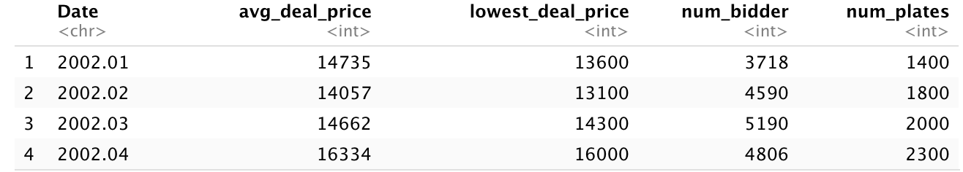
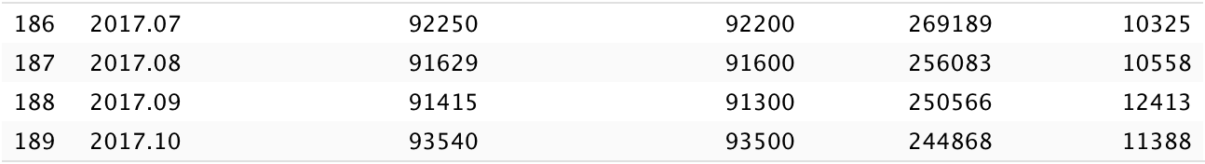
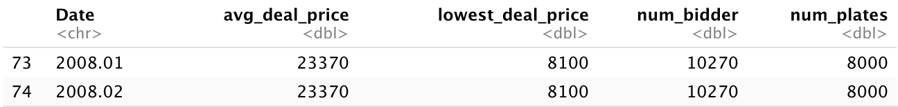
Dataset
Kaggle - license_plates_acution_data.csv
….
EDA
EDA Process - naive imputation for February 2018

Slide 5
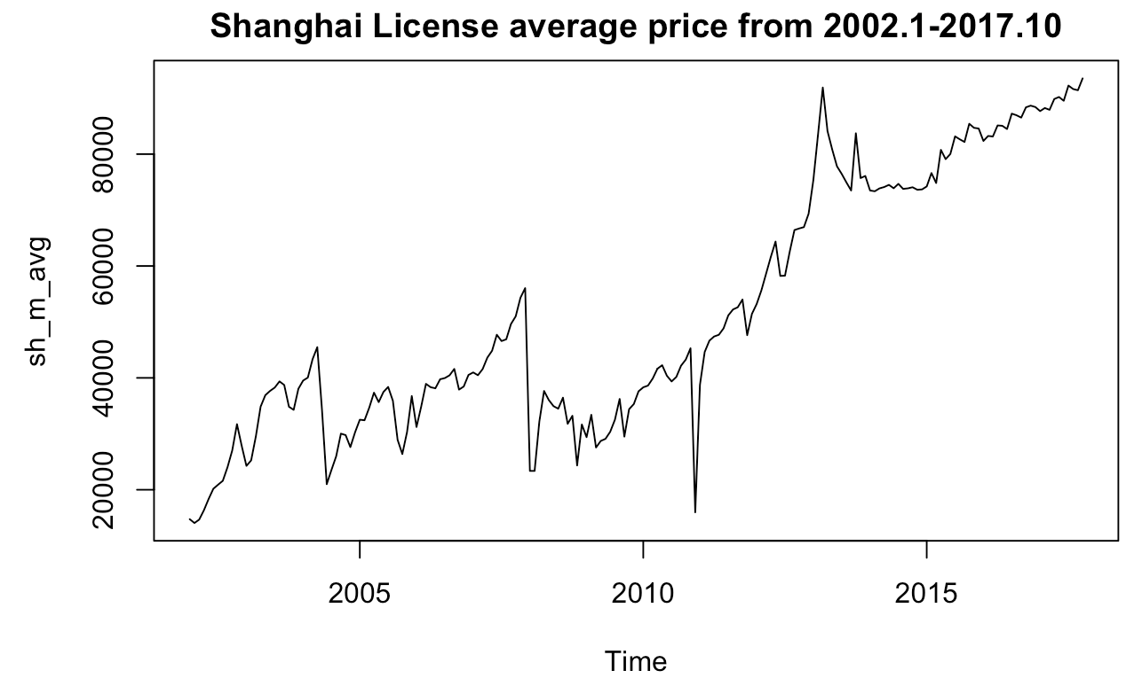
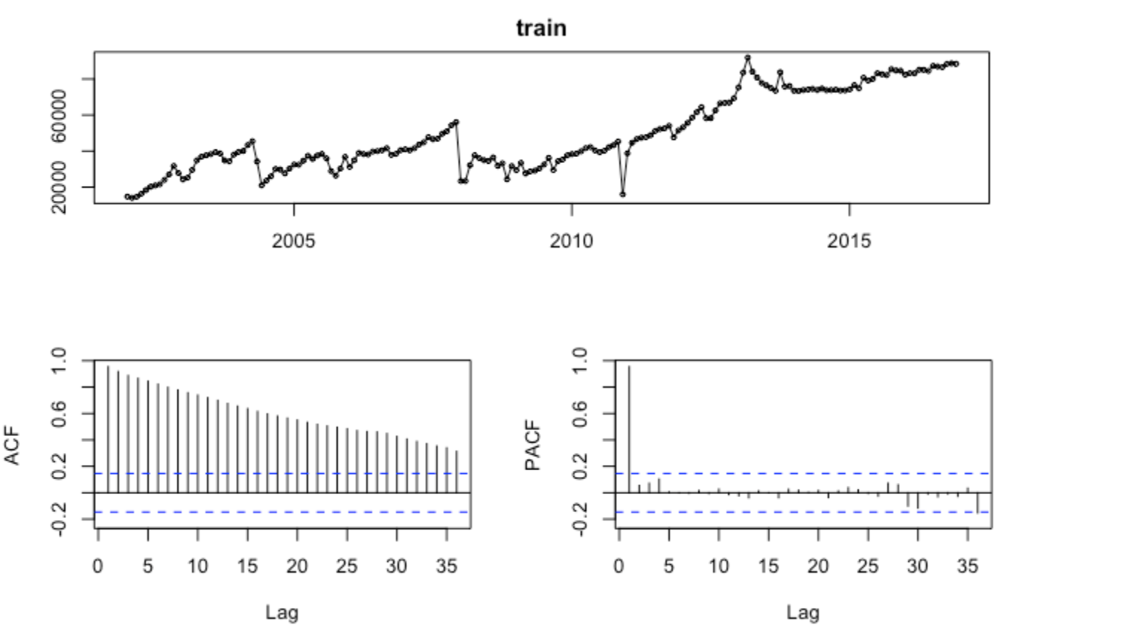
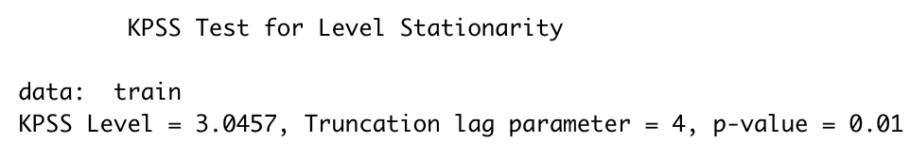
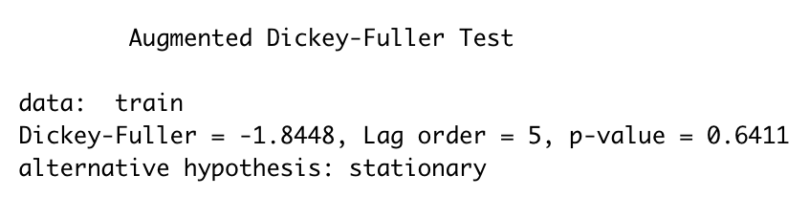
General
Plot/Test
3 Main Outliers:
2002 - November
2008 - January
2010 - December
Transformation
KPSS/ADF -> differencing 1
Box Cox Transformation is not applicable:

Slide 6
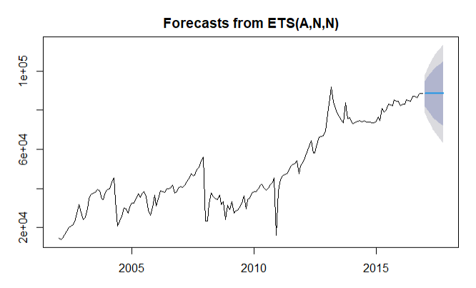
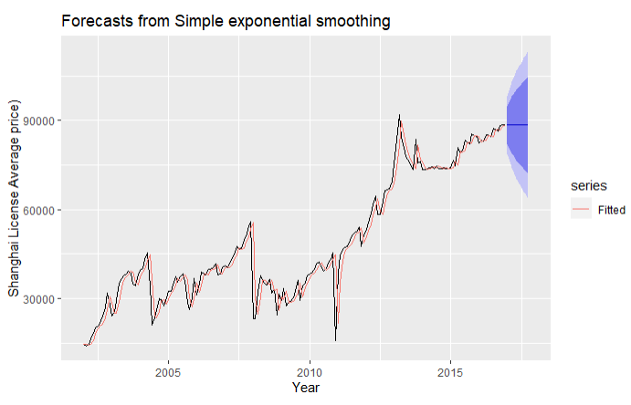


ETS & Exponential smoothing
ETS(A,N,N) shows that a method with additive error, no trend and no seasonality, applying Simple Exponential Smoothing
Notes:
Xinglin Chen

Slide 7
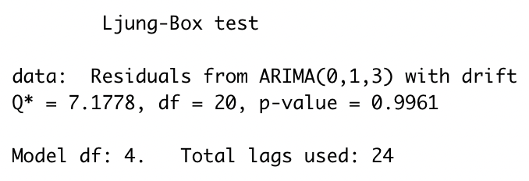
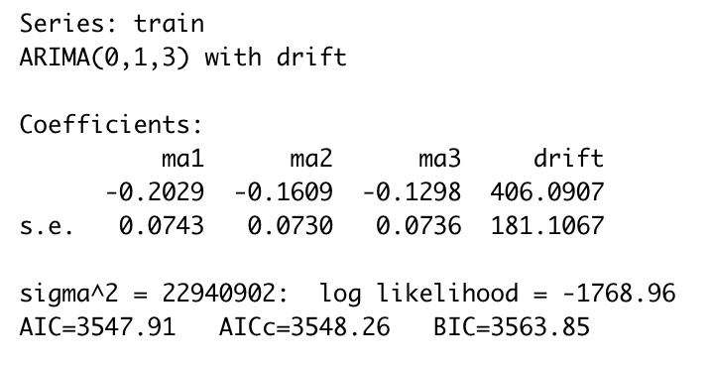
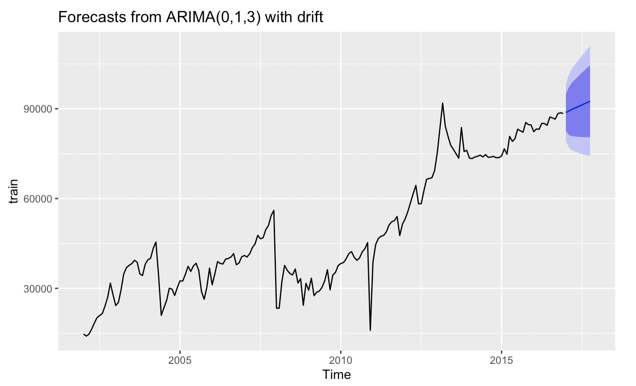
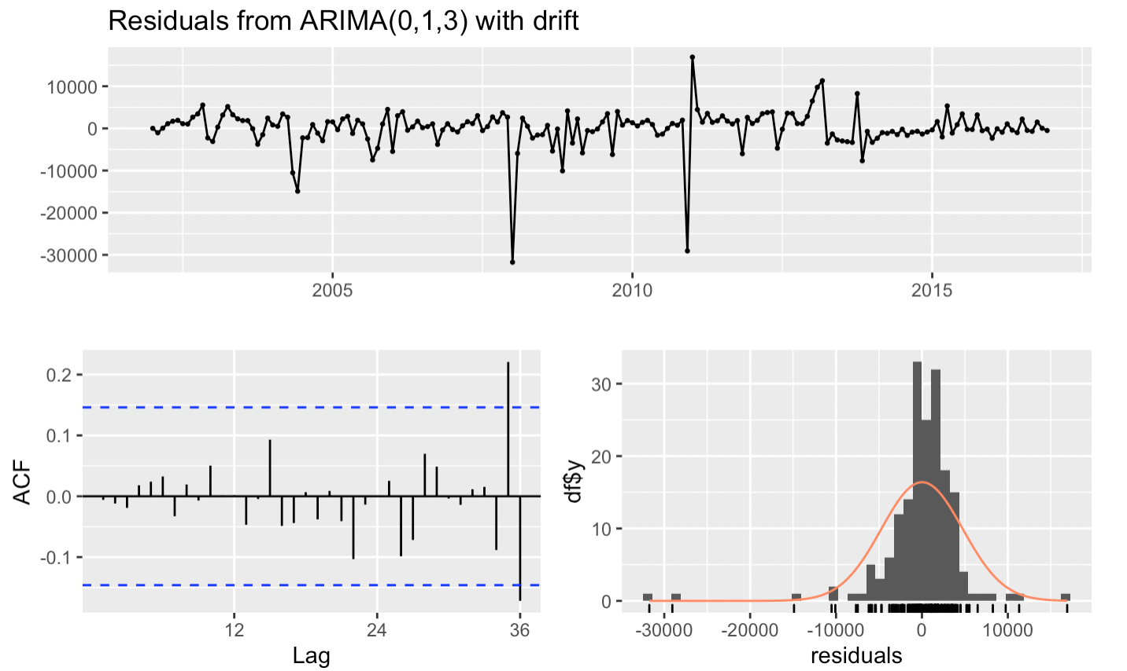
Arima Model

Slide 8
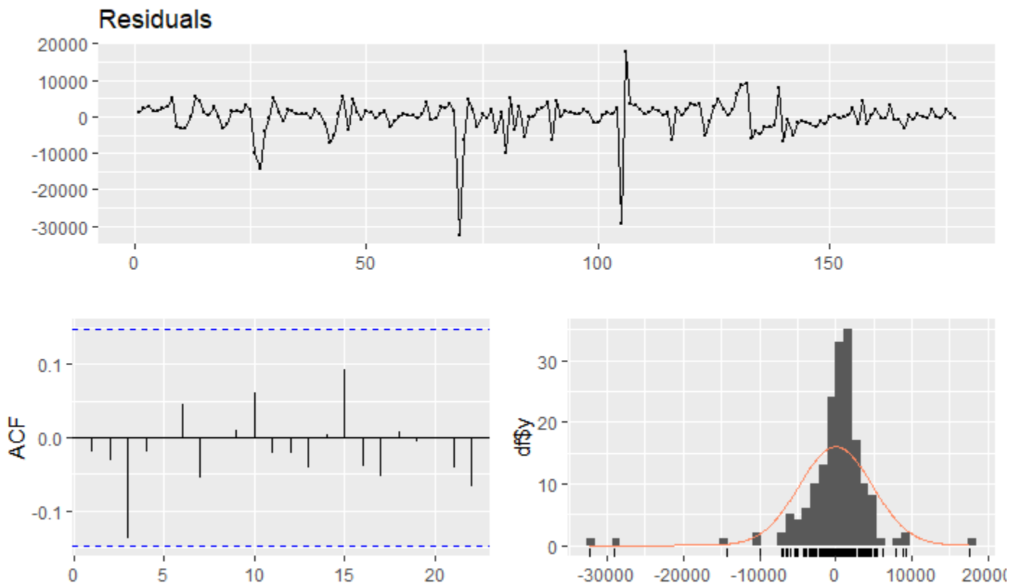
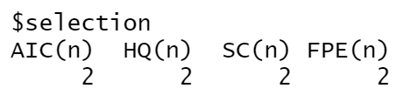
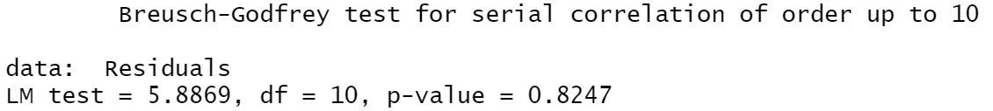
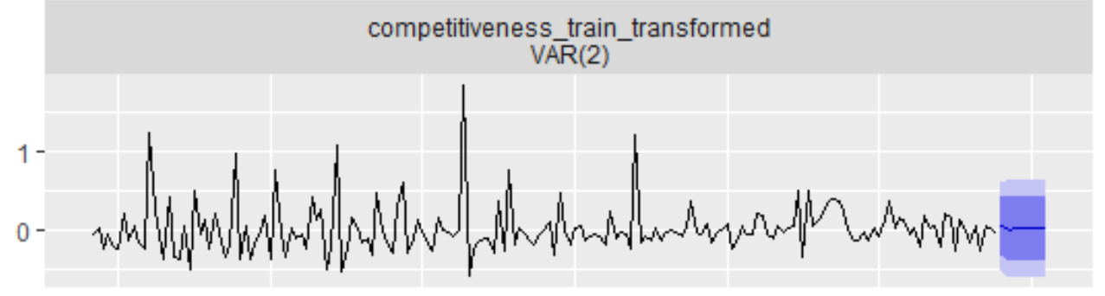
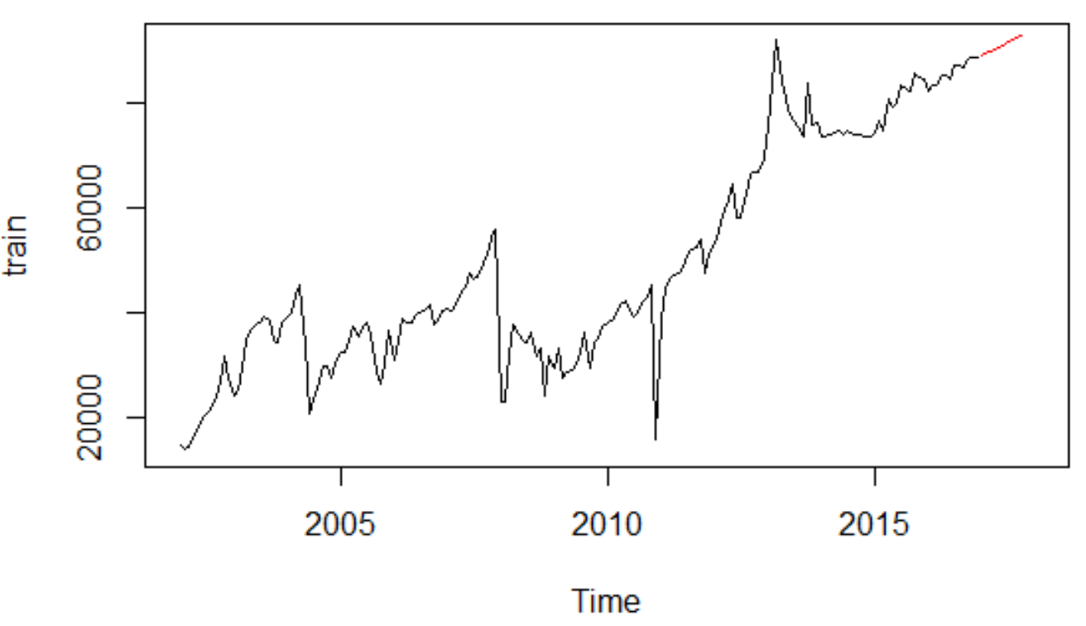
Vector Autoregressions

Slide 9
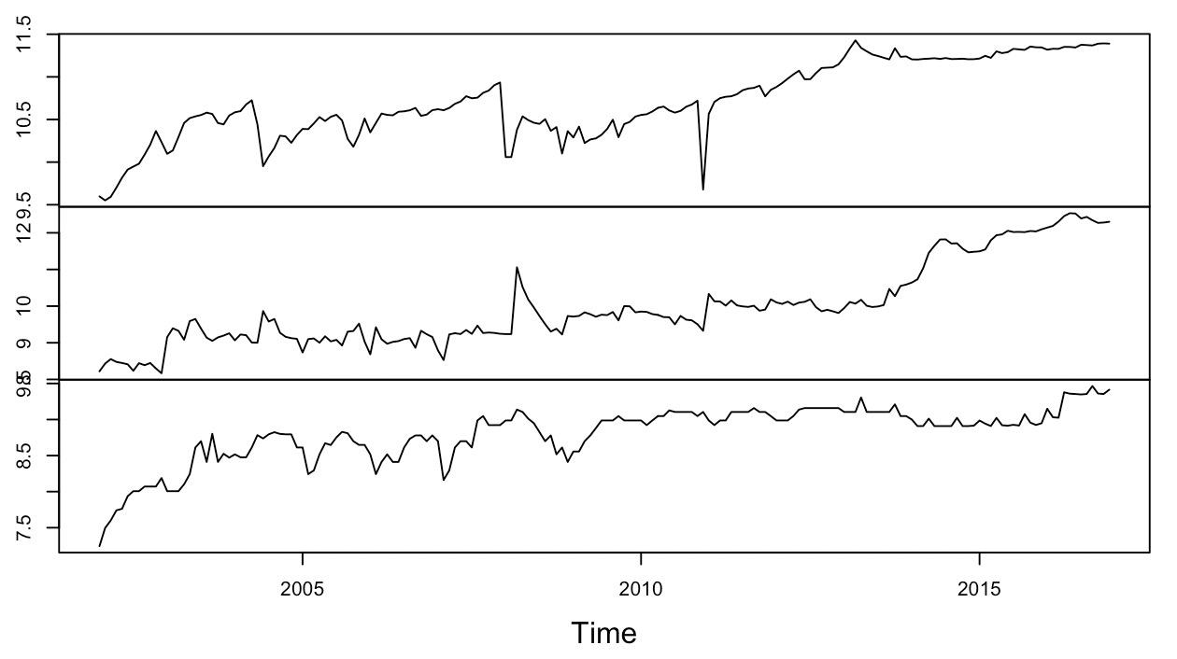
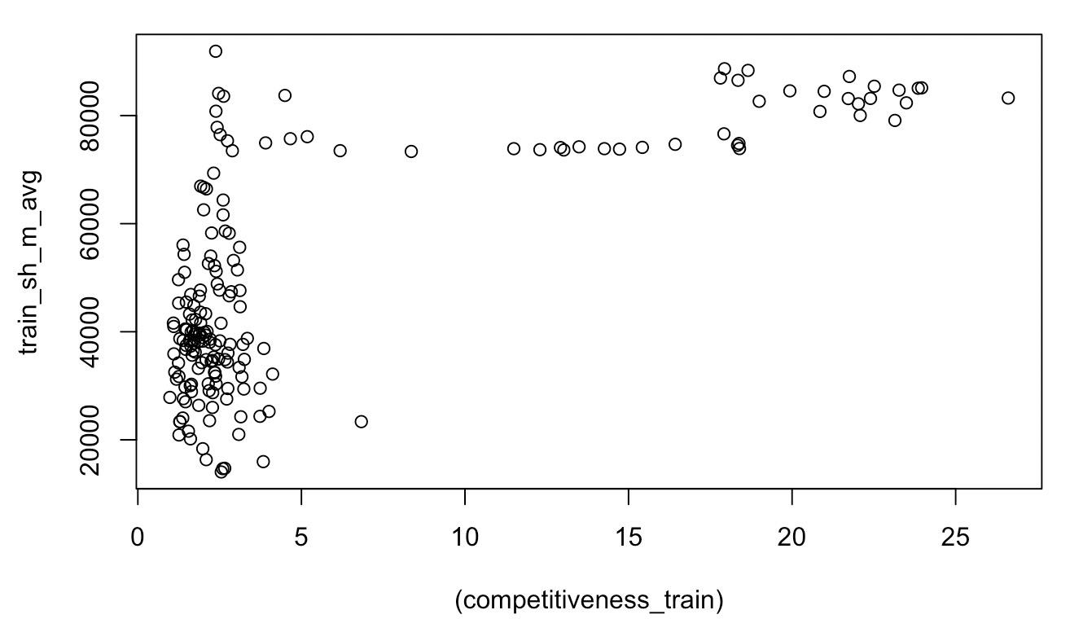
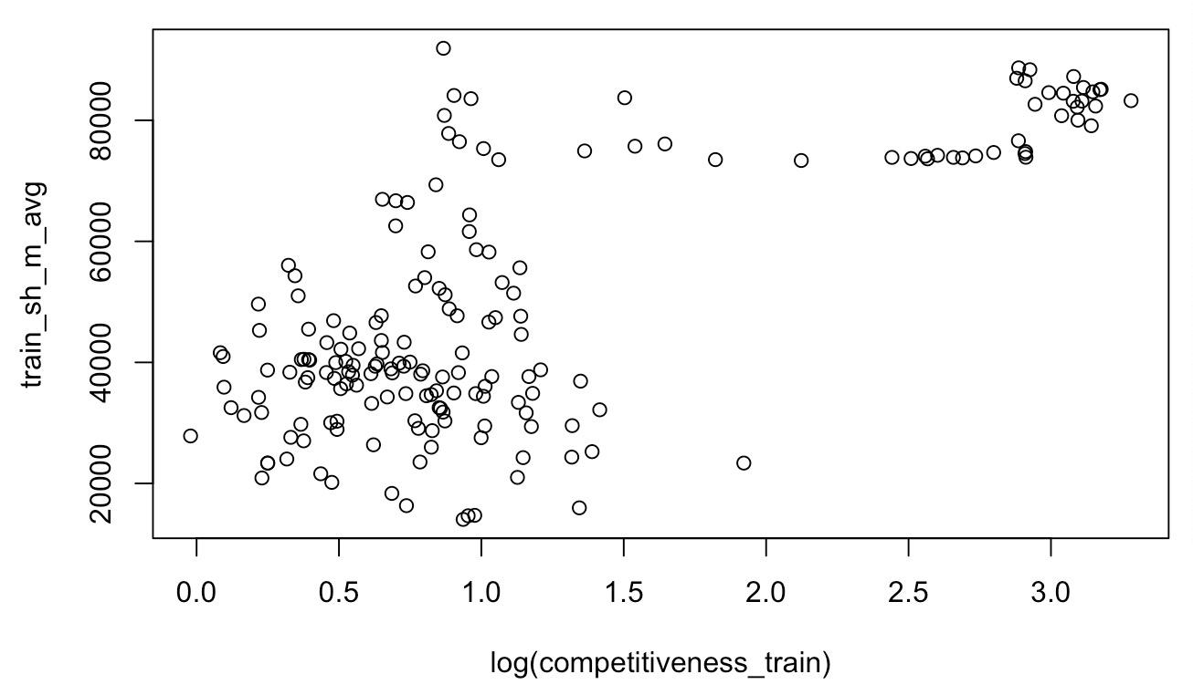
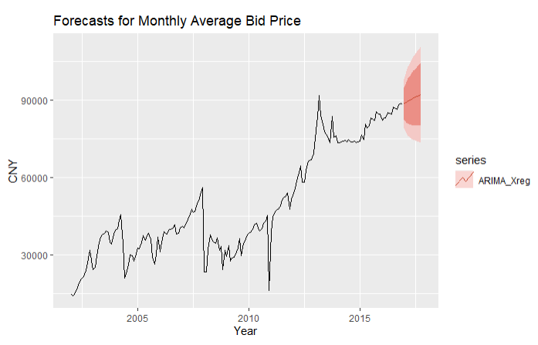
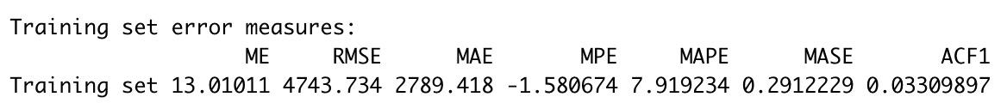
ARiMA with Exogenous Regressor
Average price
Number of Bidder
Number of Plate
Competitiveness = number of plates/number of bidders
Log of Competitiveness
Notes:
Yue Liu
Figure on the left shows the monthly changes in average price, number of bidder, number of plates in shanghai from 2002 Jan to 2016 Dec. We would like to forecast changes in average bid price of plate based on changes in number of plates available and bidders. That’s why we define competitiveness as number of plate/ number of bidder. A change in competitiveness does not necessarily translate to an instant change in average bid price (e.g.). However, we will ignore this complexity here and try to measure the instantaneous effect of the average change of bid price on the average change of competitiveness.
After log, it is more Scattered around

Slide 10
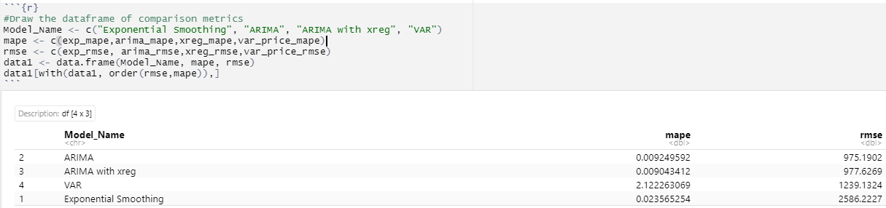
Test Performance Comparison

Slide 11
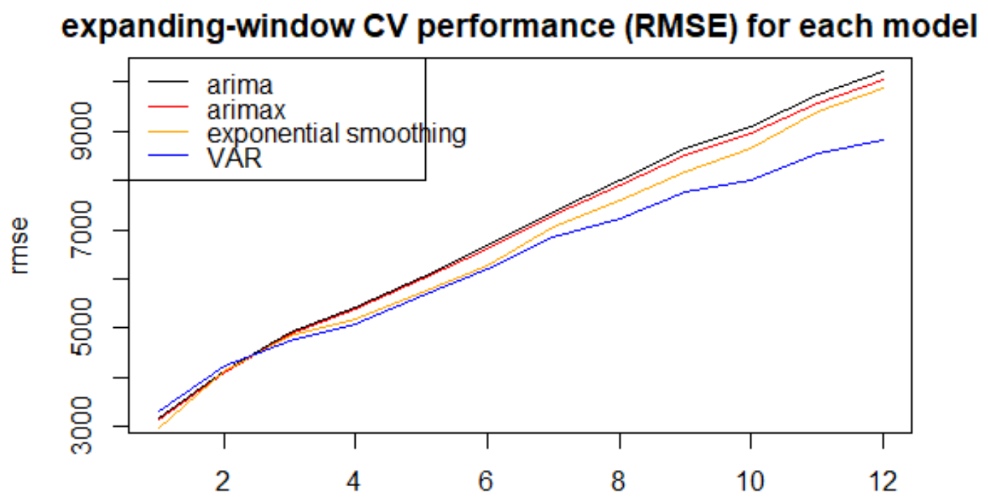
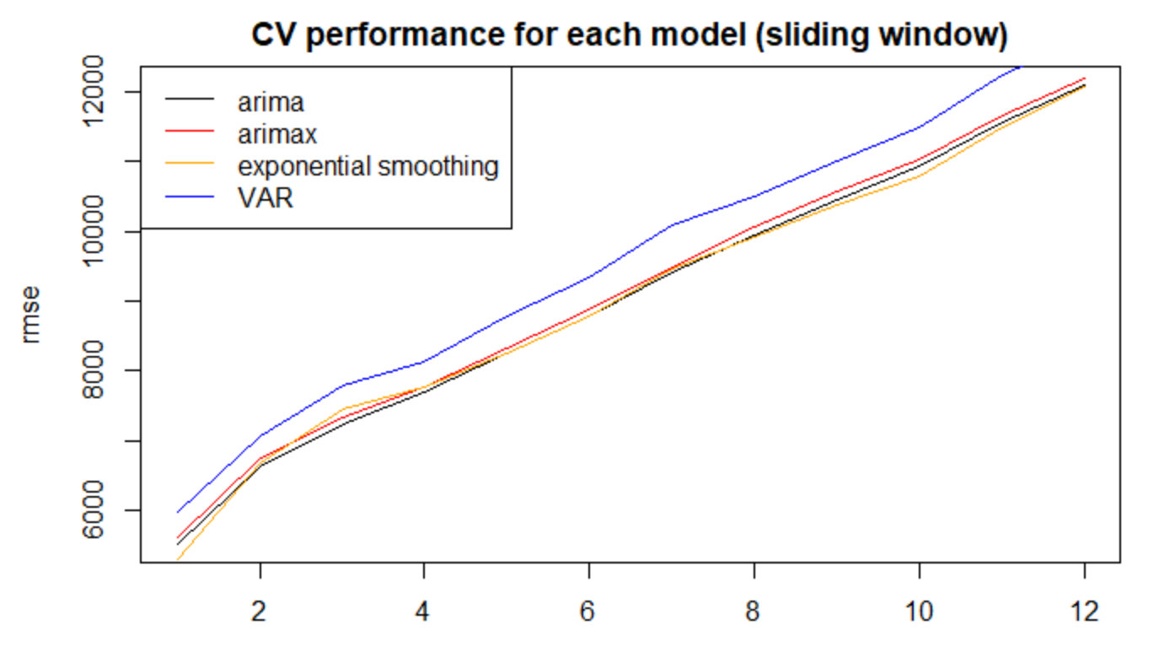
Model Selection & Project Result
long term prediction - VAR
Base on the VAR forecast plot, we can tell that such auction formats has reduced license prices’ increasing rate successfully, comparing with the previous climbing trend.
But the overall increasing rate is not shrinking distinctly.
Future Work: Intervention analysis

Slide 12
Q&A
Thank
You

